Slide 1
Coherence Prediction on Distributed Shared Memory Machines
Preston Glenn, Jason Ho, Madison Threadgill
Notes:
Today, we will present on Coherence Prediction on Distributed Shared Memory Machines

Slide 2
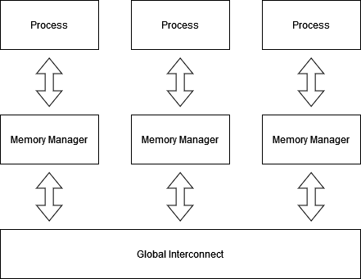
Introduction
Distributed Shared Memory (DSM) Machines
Servers and data center use this paradigm
Shared Memory split between all nodes
Virtual contiguous memory maintained by coherence protocols
Coherency on DSM Machines
Directories at each Main Memory per Node
Global Interconnect to send messages
Incurs network latencies
Notes:
Distributed shared memory machines are found in all types of servers and data centers. Using off the shelf components, many computers are joined together. While there is a virtual contiguous memory, under the hood, it is maintained by directory-based coherence protocols.
Next to each main memory, there are directories which track which nodes have access to blocks of memory. There is a global interconnect that links all nodes, meaning that coherency messages incur network latency.

Slide 3
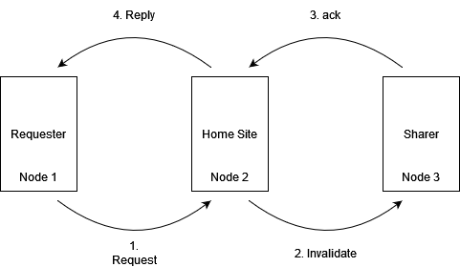
Motivation: Coherence Traffic Example on DSMs
Worst number of unique messages for write permission to a cache line
Notes:
Let’s go back to lab 2. If a remote processor wanted to write and there was a previous sharer, it sends a request to the homesite. Then, the homesite would send an invalidation request to the remote sharer, the sharer would need to acknowledge the request and once all sharers
had acknowledged, the home site can finally grant permission to the requester.
Remote access delays are long and the processor can stall, waiting on requests to be fulfilled. This does not even factor in lossy networks, messages sitting in queues, and corrupted data.

Slide 4
Motivation
IDEA: Hide Network Latency through speculation on coherence?
Notes:
How can we speed this up?
One idea is to hide remote access latency through speculation on coherence.

Slide 5
Motivation: Example Walkthrough
Worst number of unique messages for write permission to a cache line
Notes:
Back to our example, let’s consider where to speculate.

Slide 6
Motivation: Example Walkthrough
Worst number of unique messages for write permission to a cache line
Value Speculation (Dangerous and Expensive if Wrong)
Notes:
Speculating replies are dangerous and can leave a line’s coherence in a incoherent state.

Slide 7
Motivation: Example Walkthrough
Worst number of unique messages for write permission to a cache line
Value Speculation (Dangerous and Expensive if Wrong)
Predict Requests? Similar to Prefetcher
Notes:
Predicting requests is similar to prefetching. If we do it at the home site, which has the global accesses and order of accesses on a cache line, we may be able to do better.

Slide 8
Motivation: Example Walkthrough
Worst number of unique messages for write permission to a cache line
Value Speculation (Dangerous and Expensive if Wrong)
Predict Home Site Requests on Processor Lines?
Predict Requests? Similar to Prefetcher
Notes:
What about the last two? Can we predict home site requests at the processor, such as invalidates and shared permission requests?
Let’s try and formalize our taxonomy beyond this example on a MESI protocol transition diagram.

Slide 9
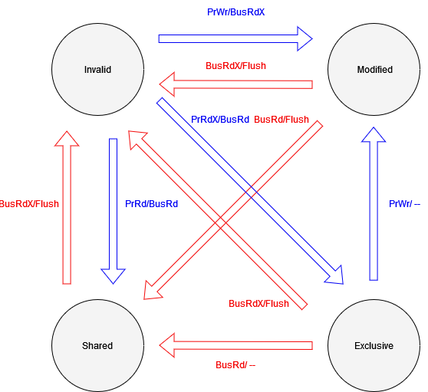
Motivation: MESI Protocol State Transitions
Blue - Processor Actions
Red - Bus Transactions
Notes:
Here, we show only the state transitions of a MESI protocol.

Slide 10
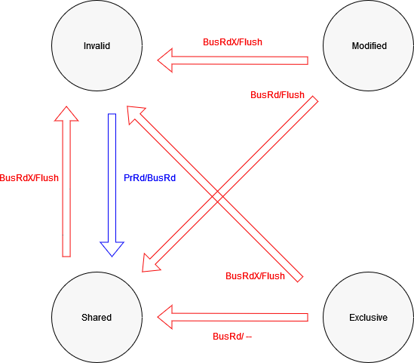
Motivation: MESI Protocol State Transitions
Blue - Processor Actions
Red - Bus Transactions
Notes:
Now, let us get rid of some processor actions: invalid to modified, invalid to exclusive, and exclusive to modified. The first two can be scary to predict, as the consequenting invalidations may invalidate lines useful lines to remote processors. Going from exclusive to modified is a silent promotion.
We can now group the remaining state transitions.

Slide 11
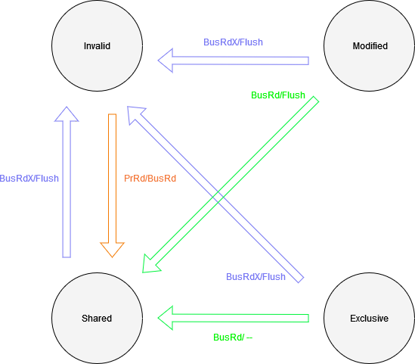
Motivation: MESI Protocol State Transitions
Purple - Bus Write Prediction (Invalidation Prediction)
Orange - Bus Read Prediction (Consumer Prediction)
Green - Shared Permission Prediction
Notes:
Here, the purple and green represent transitions where a processor may need to respond to requests from the homesite.
The orange represents reader prediction and is something already done by the prefetcher, but with no information of other processor access patterns. At the home site, perhaps there is room to innovate, since it has global information on a cache line’s history. This is called consumer prediction.

Slide 12
Related Work
Mukherjee and Hill propose Cosmos Predictor in 1998 [1]
General coherence message predictor using modified two-level branch predictor
Lai and Falsafi propose Memory Sharing Predictor in 1999 [2]
Only store and predict requests
No need to store subsequently generated message request
Kaxiras and Young propose a coherence prediction taxonomy in 1999 [3]
Consumer prediction provides best speedup
Memory Address, Processor ID matter most in prediction
Leventhal and Franklin propose Perceptron Consumer Prediction in 2006 [4]
Use perceptron, allowing linear scaling of history length
Perceptron to weigh other processor’s histories on if a processor is a consumer
Notes:
We now talk about related work.
In 1998, mukherjee and hill propose general coherence message prediction using a modified two-level branch predictor. They call this the Cosmos predictor.
One year later, Lai and Falsafi found that we only need to predict and store requests
That same year, Kaxiras and Young propose a coherence prediction taxonomy and find that consumer prediction provides the best benefit out of all coherence prediction.
A few years later, Leventhal and Franklin use a perceptron on the consumer prediction task.
Since then, there has been little to no work in the coherence prediction field. Following the advice of Kaxiras and Young, we focus on consumer prediction.

Slide 13
Research Objectives
Analyze a Modern Benchmark Suite Shared Memory Access Pattern
PARSEC Benchmark Suite [5]
Evaluate homesite consumer prediction schemes benchmark suite
Notes:
So what did we want to do? Since there has not been work since 2006, we first analyzed the headroom for coherence prediction in a modern benchmark suite. We choose PARSEC, a shared memory parallel benchmark suite.
After that, we created and evaluated two consumer prediction schemes on those benchmarks.

Slide 14
Experimental Methodology
Used 7 out of 10 PARSEC 3.0 benchmarks
x264, ferret, and facesim were excluded due to input segmentation faults
Ran for 30 minutes each
Computer Specifications
1 node of TACC Lonestar 6 Cluster
Each node has 2, 64 core AMD EPYC 7763 CPUs with 256 Gb of DRAM
Benchmark ran with 32 cores
Instrumentation Tools
Intel PIN 3.28 with a custom tool for multithreaded memory used to obtain memory traces on top of benchmark runs on TACC
Analysis with cache block size of 128 bytes
Notes:
We use 7 out of 10 PARSEC benchmarks, as we were unable to get the others to run. We run each for 30 minutes on one node of the TACC Lonestar6 cluster with 32 cores. To get the memory traces, we developed a thread-safe PIN tool that obtains all memory accesses and annotates lock acquisitions and failures.
We perform our analysis with a cache block size of 128 bytes.

Slide 15
Benchmark Statistical Analysis
Benchmark | Shared Cache Lines % (Total) | Shared Cache Lines % (Program) | Shared Cache Line % (OS) | Average Unique Consumers per Prediction (Total) | Average Unique Consumers per Prediction (Program) | Average Unique Consumers per Prediction (OS) | Average Possible Predictions per Shared Cache Line (Total) | Average Possible Predictions per Shared Cache Line (Program) | Average Possible Predictions per Shared Cache Line (OS)
blacksholes | 0.06% | 0% | 100% | 32 | 0 | 32 | 1 | 0 | 1
bodytrack | 12.37% | 0.65% | 99.35% | 1.66828271 | 2.991071429 | 1.480522946 | 6.962179748 | 133 | 6.136717151
facesim | 0.24% | 0.00% | 100.00% | 2.208955224 | 0 | 2.208955224 | 22.33333333 | 0 | 22.33333333
fluidanimate | 11.14% | 95.55% | 4.45% | 1.198496122 | 1.101855807 | 1.668513389 | 1.631301779 | 1.416117758 | 6.251082251
freqmine | 0.47% | 98.55% | 1.45% | 2.259865255 | 1.908146528 | 4.843373494 | 1.366655705 | 1.220553887 | 11.31818182
raytrace | 4.71% | 0 | 100.00% | 1.84496124 | 0 | 1.84496124 | 4.3 | 0 | 4.3
swaptions | 0.24% | 100.00% | 0.00% | 3.649038462 | 3.649038462 | 0 | 9.043478261 | 9.043478261 | 0
vips | 0.03% | 0 | 100.00% | 3.765625 | 0 | 3.765625 | 2.37037037 | 0 | 2.37037037
Notes:
Here, we show the results of our statistical analysis on the benchmark suite memory traces.
We find that in each benchmark, the total percentage of shared cache lines is relatively low as shown by the red rectangle.

Slide 16
Benchmark Statistical Analysis
Benchmark | Shared Cache Lines % (Total) | Shared Cache Lines % (Program) | Shared Cache Line % (OS) | Average Unique Consumers per Prediction (Total) | Average Unique Consumers per Prediction (Program) | Average Unique Consumers per Prediction (OS) | Average Possible Predictions per Shared Cache Line (Total) | Average Possible Predictions per Shared Cache Line (Program) | Average Possible Predictions per Shared Cache Line (OS)
blacksholes | 0.06% | 0% | 100% | 32 | 0 | 32 | 1 | 0 | 1
bodytrack | 12.37% | 0.65% | 99.35% | 1.66828271 | 2.991071429 | 1.480522946 | 6.962179748 | 133 | 6.136717151
facesim | 0.24% | 0.00% | 100.00% | 2.208955224 | 0 | 2.208955224 | 22.33333333 | 0 | 22.33333333
fluidanimate | 11.14% | 95.55% | 4.45% | 1.198496122 | 1.101855807 | 1.668513389 | 1.631301779 | 1.416117758 | 6.251082251
freqmine | 0.47% | 98.55% | 1.45% | 2.259865255 | 1.908146528 | 4.843373494 | 1.366655705 | 1.220553887 | 11.31818182
raytrace | 4.71% | 0 | 100.00% | 1.84496124 | 0 | 1.84496124 | 4.3 | 0 | 4.3
swaptions | 0.24% | 100.00% | 0.00% | 3.649038462 | 3.649038462 | 0 | 9.043478261 | 9.043478261 | 0
vips | 0.03% | 0 | 100.00% | 3.765625 | 0 | 3.765625 | 2.37037037 | 0 | 2.37037037
Notes:
The two largest percentages of shared cache lines are bodytrack and fluidanimate with 12.37% and 11.14% shared cache lines, respectively.

Slide 17
Benchmark Statistical Analysis
Benchmark | Shared Cache Lines % (Total) | Shared Cache Lines % (Program) | Shared Cache Line % (OS) | Average Unique Consumers per Prediction (Total) | Average Unique Consumers per Prediction (Program) | Average Unique Consumers per Prediction (OS) | Average Possible Predictions per Shared Cache Line (Total) | Average Possible Predictions per Shared Cache Line (Program) | Average Possible Predictions per Shared Cache Line (OS)
blacksholes | 0.06% | 0% | 100% | 32 | 0 | 32 | 1 | 0 | 1
bodytrack | 12.37% | 0.65% | 99.35% | 1.66828271 | 2.991071429 | 1.480522946 | 6.962179748 | 133 | 6.136717151
facesim | 0.24% | 0.00% | 100.00% | 2.208955224 | 0 | 2.208955224 | 22.33333333 | 0 | 22.33333333
fluidanimate | 11.14% | 95.55% | 4.45% | 1.198496122 | 1.101855807 | 1.668513389 | 1.631301779 | 1.416117758 | 6.251082251
freqmine | 0.47% | 98.55% | 1.45% | 2.259865255 | 1.908146528 | 4.843373494 | 1.366655705 | 1.220553887 | 11.31818182
raytrace | 4.71% | 0 | 100.00% | 1.84496124 | 0 | 1.84496124 | 4.3 | 0 | 4.3
swaptions | 0.24% | 100.00% | 0.00% | 3.649038462 | 3.649038462 | 0 | 9.043478261 | 9.043478261 | 0
vips | 0.03% | 0 | 100.00% | 3.765625 | 0 | 3.765625 | 2.37037037 | 0 | 2.37037037
Highlighted benchmarks have opposite majority shared address spaces
Notes:
What is interesting is that of these two benchmarks, a majority of bodytrack’s shared cache line accesses come from the operating system. This suggests that most of the shared memory contention is to maintain locks.

Slide 18
Benchmark Statistical Analysis
Benchmark | Shared Cache Lines % (Total) | Shared Cache Lines % (Program) | Shared Cache Line % (OS) | Average Unique Consumers per Prediction (Total) | Average Unique Consumers per Prediction (Program) | Average Unique Consumers per Prediction (OS) | Average Possible Predictions per Shared Cache Line (Total) | Average Possible Predictions per Shared Cache Line (Program) | Average Possible Predictions per Shared Cache Line (OS)
blacksholes | 0.06% | 0% | 100% | 32 | 0 | 32 | 1 | 0 | 1
bodytrack | 12.37% | 0.65% | 99.35% | 1.66828271 | 2.991071429 | 1.480522946 | 6.962179748 | 133 | 6.136717151
facesim | 0.24% | 0.00% | 100.00% | 2.208955224 | 0 | 2.208955224 | 22.33333333 | 0 | 22.33333333
fluidanimate | 11.14% | 95.55% | 4.45% | 1.198496122 | 1.101855807 | 1.668513389 | 1.631301779 | 1.416117758 | 6.251082251
freqmine | 0.47% | 98.55% | 1.45% | 2.259865255 | 1.908146528 | 4.843373494 | 1.366655705 | 1.220553887 | 11.31818182
raytrace | 4.71% | 0 | 100.00% | 1.84496124 | 0 | 1.84496124 | 4.3 | 0 | 4.3
swaptions | 0.24% | 100.00% | 0.00% | 3.649038462 | 3.649038462 | 0 | 9.043478261 | 9.043478261 | 0
vips | 0.03% | 0 | 100.00% | 3.765625 | 0 | 3.765625 | 2.37037037 | 0 | 2.37037037
Unique consumers are low. Just one consumer for a main memory write
Highlighted benchmarks have opposite majority shared address spaces
Notes:
Now, if we look at the number of unique consumers per possible consumer prediction, we see that even on the benchmarks with the most shared cache lines, there is usually only one or two unique consumers for a write.

Slide 19
Benchmark Statistical Analysis
Benchmark | Shared Cache Lines % (Total) | Shared Cache Lines % (Program) | Shared Cache Line % (OS) | Average Unique Consumers per Prediction (Total) | Average Unique Consumers per Prediction (Program) | Average Unique Consumers per Prediction (OS) | Average Possible Predictions per Shared Cache Line (Total) | Average Possible Predictions per Shared Cache Line (Program) | Average Possible Predictions per Shared Cache Line (OS)
blacksholes | 0.06% | 0% | 100% | 32 | 0 | 32 | 1 | 0 | 1
bodytrack | 12.37% | 0.65% | 99.35% | 1.66828271 | 2.991071429 | 1.480522946 | 6.962179748 | 133 | 6.136717151
facesim | 0.24% | 0.00% | 100.00% | 2.208955224 | 0 | 2.208955224 | 22.33333333 | 0 | 22.33333333
fluidanimate | 11.14% | 95.55% | 4.45% | 1.198496122 | 1.101855807 | 1.668513389 | 1.631301779 | 1.416117758 | 6.251082251
freqmine | 0.47% | 98.55% | 1.45% | 2.259865255 | 1.908146528 | 4.843373494 | 1.366655705 | 1.220553887 | 11.31818182
raytrace | 4.71% | 0 | 100.00% | 1.84496124 | 0 | 1.84496124 | 4.3 | 0 | 4.3
swaptions | 0.24% | 100.00% | 0.00% | 3.649038462 | 3.649038462 | 0 | 9.043478261 | 9.043478261 | 0
vips | 0.03% | 0 | 100.00% | 3.765625 | 0 | 3.765625 | 2.37037037 | 0 | 2.37037037
Unique consumers are low. Just one consumer for a main memory write
Highlighted benchmarks have opposite majority shared address spaces
OS space cache lines used more, so more history for prediction
Notes:
Finally, we look at the average possible predictions per shared cache line. This represents the amount of history that a cache line would theoretically have and can use to predict future consumers. This is also low for our two highlighted benchmarks, suggesting that a consumer prediction task per cache line may be difficult due to a lack of history.

Slide 20
Benchmark Statistical Analysis Takeaways
Most PARSEC parallel benchmarks are data-parallel and independent
blacksholes, facesim, freqmine, raytrace, swaptions, vips have little to no shared cache lines
Average number of consumers per possible prediction close to 1
Only one possible consumer (or processor to invalidate) for coherence prediction
Average number of possible predictions per cache line is low
Limited memory per cache line makes prediction difficult
Notes:
So what can we take away from those statistics.
Most PARSEC benchmarks are parallel and mostly independent with little to no shared cache line usage.
The average number of consumer per prediction is close to 1, limiting the performance gains of consumer prediction.
The number of possible predictions per cache line is low, limiting the amount of history that one can use to make predictions of the future.

Slide 21
Benchmark Statistical Analysis Takeaways
Most PARSEC parallel benchmarks are data-parallel and independent
blacksholes, facesim, freqmine, raytrace, swaptions, vips have little to no shared cache line use
Benchmarks have at most 12.37% shared cache lines in bodytrack
Parallel applications limit shared memory communication
Average number of consumers per possible prediction close to 1
Only one possible consumer (or processor to invalidate) for coherence prediction
Average Number of Possible Predictions per cache line is low
Limited memory per cache line makes prediction difficult
Accurate Coherence Prediction is difficult with limited headroom
Notes:
Simply put, coherence prediction is difficult and has limited opportunity.

Slide 22
Research Objectives
Analyze a Modern Benchmark Suite Shared Memory Access Pattern
PARSEC Benchmark Suite [5]
Evaluate homesite consumer prediction schemes benchmark suite
Notes:
Moving on to evaluating homesite consumer prediction schemes, we first introduce our consumer prediction schemes despite the pessimistic discoveries we made in our statistical analysis.
We have two schemes: LRU consumer prediction, and a modification, which we call Override consumer prediction.

Slide 23
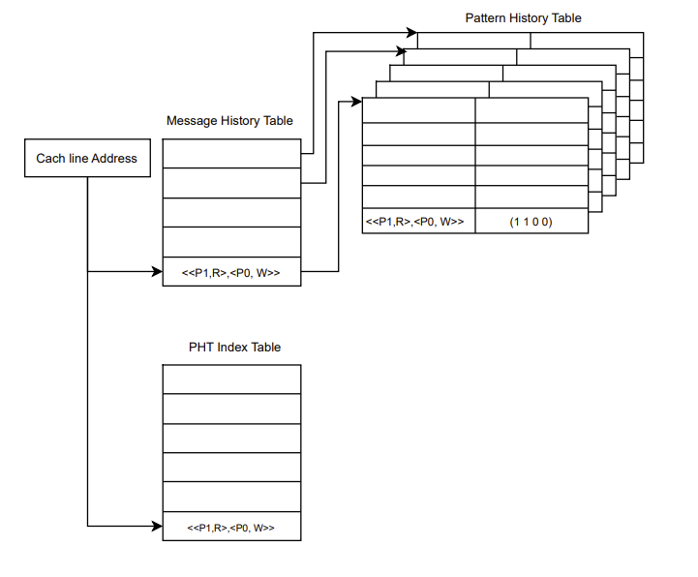
LRU Consumer Prediction Scheme
Notes:
To tackle the consumer prediction problem, we modify the Cosmos two-level predictor to predict which processors will be a consumer of a write rather than all general coherence messages. Our first prediction scheme has three main components.
First of all, Just like Cosmos, it has a Message History Table or MHT, that consists of Message History Registers or MHR, where each cache line owns an MHR. Each MHR tracks the last few memory access that the homesite sees. In particular the MHR tracks tuples that consist of processor ID, and whether the request was a read or read with intent to modify.
The second component is the pattern history table or PHT. Each cache line has its own PHT that is indexed by the MHR. We modify Cosmos’ PHT, which would predict a coherence protocol message, to predict a one-hot bit array, where each bit represents whether a processor will be a consumer or not.
One issue arises though, in that we need to be able to update a particular entry in the PHT long after the MHR for that cache line has been updated by various reads.
The last component is the PHT Index Table or the (PIT), where each cache line is assigned an entry and tracks what the MHR was at the time of the last RWITM to that cache line,

Slide 24
LRU Consumer Prediction Scheme
Reads:
Update MHT
Upgrade PHT with reader by
indexing with PIT
RWITM:
Update MHT
Access PHT with MHR to get prediction
Update PIT for cache line
Notes:
How does it actually work? For each message that the homesite receives, we determine if its a Read or a RWITM. If its a Read, then the homesite simply needs to update the cache line’s MHT and PHT. To upgrade the PHT, we index into it at the cache line’s PIT and upgrade the bit that corresponds to the processor that requested the cache line.
Now, when the homesite receives a RWITM, we first update the MHT, and then we access the cache line’s prediction by indexing into its PHT using the cache line’s MHR. Then, we update the PIT from the current status of the MHT.
Finally, each PHT is constrained to some limited size, thus in our initial solution, the replacement policy for lines in the PHT was LRU like Cosmos. However, this poses a problem. Since the bit array values are only upgraded to consumer
and never downgraded, the only way to fix changed pattern behavior or ruined entries is through LRU.
In the next implementation, we address this issue.

Slide 25
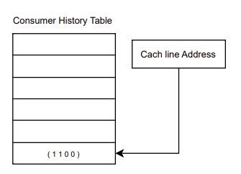
Overide Consumer Prediction Scheme
Adds a Consumer History Table (CHT)
Tracks current consumers of most recent RWITM
Reads:
Update MHT and CHT
RWITM:
Update MHT
Access PHT with MHR to get prediction
Update PHT with CHT using PIT
Clear CHT
Notes:
To address the previous problem, we introduce a final table, the Consumer History Table (CHT), which tracks which processors have requested the latest write to a cache line.
In this implementation, Reads update the MHT and instead of directly updating the PHT they upgrade a bit in the CHT.
To handle RWITM, we adjust the predictor more. It starts the same, with an update to the MHT and then similarly it makes a prediction by indexing into the cache line’s PHT with its MHR. After that though we differ as we then override the PHT entry at the PHT Index Table with CHT.
Once a new write arrives on a line, we have a finalized list of the consumers for the previous write, and can update the PHT at the last writer’s index the PIT. We then clear the CHT.
While we still rely on LRU to kick out entries in the PHT when it full, we no longer rely on it to downgrade predictions to non-consumers.

Slide 26
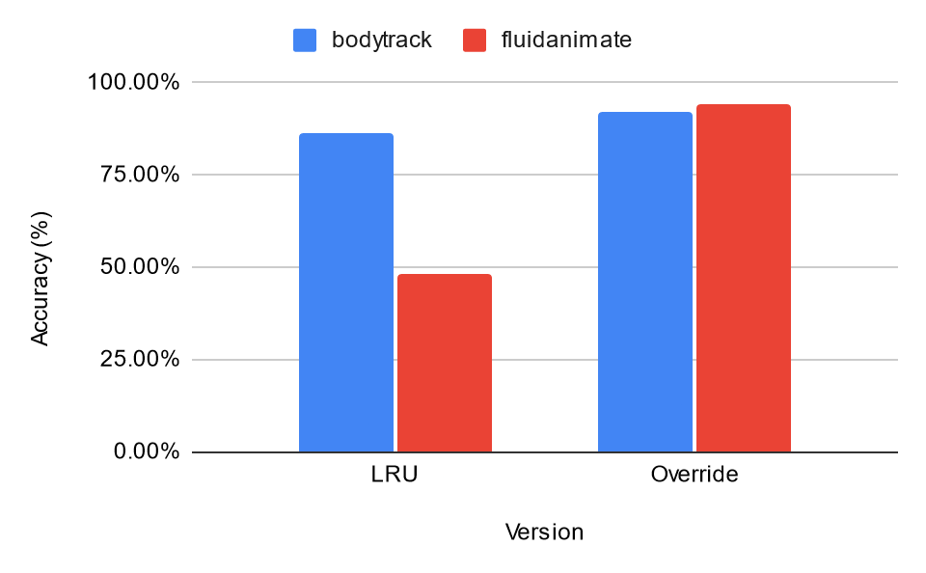
Consumer Prediction Results
MHR Depth = 3 ; One Bit/Processor Prediction
Notes:
We run our two consumer predictors on the two highlighted benchmarks from before with the most shared lines. We initially run our predictors with a history of 3 and a one bit counter per processor at the PHT.
We note that we take a pessimistic approach to accuracy, meaning that for a singular prediction, a consumer predictor must predict the consumer state of all processors correctly to be considered as correct.

Slide 27
Consumer Prediction Results
LRU predictor performs worse than Override
MHR Depth = 3 ; One Bit/Processor Prediction
Notes:
We find that the Override predictor performs significantly better on both benchmarks than LRU since it is able to update quicker.

Slide 28
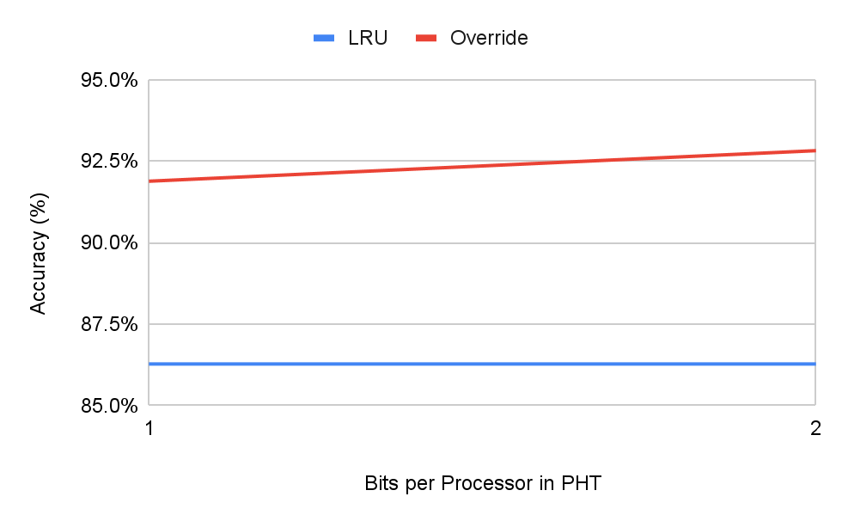
Consumer Prediction Bit Sensitivity
MHR Depth = 3
Notes:
We also perform a bit sensitivity analysis on our consumer predictors. This graph shows the bodytrack workload where we run on one bit and two bit saturating counters at the PHT per processor.

Slide 29
Consumer Prediction Bit Sensitivity
Increasing number of bits in saturating counter slightly increases performance at 2x memory
MHR Depth = 3
Notes:
We find that while we can slightly increase performance of both predictors, it is not worth the 2x memory cost. This trend is similar on the fluidanimate benchmark. Because of this, for future tests, we show only one bit predictors.

Slide 30
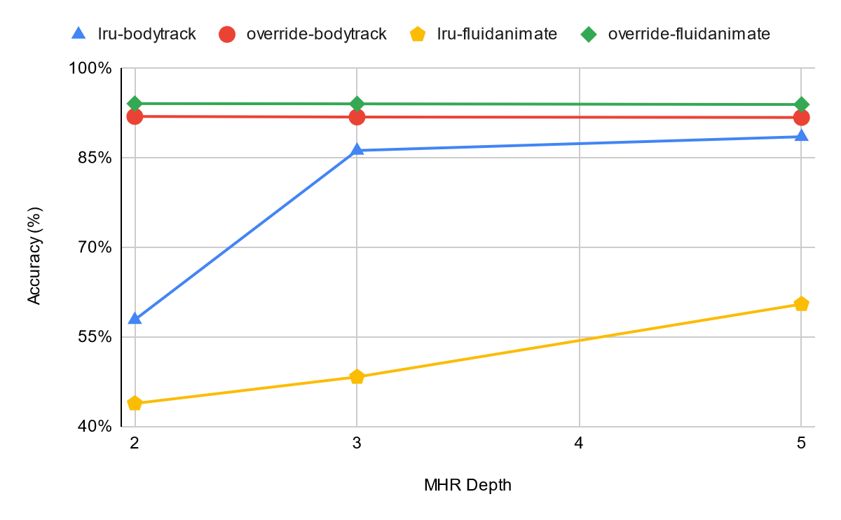
Consumer Prediction History Depth Sensitivity
One Bit/Processor Prediction
Notes:
We also perform sensitivity analysis on the depth of MHR entries for both predictors. This is the access history of a cache line, as seen from the home site.

Slide 31
Consumer Prediction Results
LRU performs better with more history
One Bit/Processor Prediction
Notes:
We find that the LRU performs better with more history of the past as shown by the yellow and blue lines.

Slide 32
Consumer Prediction Results
LRU performs better with more history
Override performs well with irrespective of history depth
One Bit/Processor Prediction
Notes:
In contrast, the override performs well irrespective of history depth with an average accuracy of 92% on both benchmarks.

Slide 33
Research Objectives
Analyze a Modern Benchmark Suite Shared Memory Access Pattern
PARSEC Benchmark Suite [5]
Evaluate homesite consumer prediction schemes benchmark suite
Notes:
Now we have demonstrated and evaluated two homesite consumer prediction schemes.

Slide 34
Conclusion
Statistical analysis of coherence prediction opportunity on the PARSEC 3.0 benchmark suite
Little opportunity on tested benchmarks with little history, making the task difficult.
Proposed two consumer predictors at the homesite
LRU Consumer Prediction
Override Consumer Prediction
Notes:
In conclusion, we find that from our statistical analysis of PARSEC 3.0, there is limited opportunity with little history, making the prediction task difficult.
We then proposed two consumer predictors at the home site: the LRU and Override predictors.
The Override predictor performs better than the LRU in all cases that we tested, with an average accuracy of 92% on all runs of bodytrack and fluidanimate.

Slide 35
Future Work
Get all PARSEC benchmarks working and run longer experiments
Examine other parallel, shared memory workloads which may have more consumers in a consumer-producer scheme
Look at database and datacenter workloads
Analyze memory footprint of Consumer Predictors
Evaluate the Override Consumer Predictor on a cycle-accurate simulator to get speedup
Look into Homesite Request Prediction
Notes:
In the future, we hope to fix the other PARSEC benchmarks, and run longer experiments with more cores.
Since PARSEC may not be representative of all parallel workloads, we hope to trace other workloads and determine if consumer prediction may be useful there.
We hope to evaluate the proposed consumer predictors’s memory footprint and the possible speedup that it can achieve on a simulator.
Lastly, there is still more work that can be done in coherence prediction, primarily homesite request prediction, that we did not touch upon in our study.

Slide 36
Thank You!
Notes:
Thank you!

Slide 37
Thank You!
Any Questions?
Notes:
Any questions?

Slide 38
Just kidding, its recorded :)
Notes:
Just kidding :)

Slide 39
References
[1] Shubhendu S. Mukherjee and Mark D. Hill. “Using Prediction to Accelerate Coherence Protocols”. In: Proceedings of the 25th Annual International Symposium on Computer Architecture. ISCA ’98. Barcelona, Spain: IEEE Computer Society, 1998, pp. 179–190. isbn: 0818684917. doi: 10.1145/279358.279386. url: https://doi.org/10.1145/279358.279386.
[2] An-Chow Lai and B. Falsafi. “Memory sharing predictor: the key to a speculative coherent DSM”. In: Proceedings of the 26th International Symposium on Computer Architecture (Cat. No.99CB36367). Proceedings of the 26th International Symposium on Computer Architecture (Cat. No.99CB36367). ISSN: 1063-6897. May 1999, pp. 172–183. doi: 10.1109/ISCA.1999.765949. url: https://ieeexplore.ieee.org/document/765949
[3] S. Kaxiras and C. Young. “Coherence communication prediction in shared-memory multiprocessors”. In: Proceedings Sixth International Symposium on High-Performance Computer Architecture. HPCA-6 (Cat. No.PR00550). HPCA: 6th International Symposium on High-Performance Computer Architecture. Touluse, France: IEEE Comput. Soc, 1999, pp. 156–167. isbn: 978-0-7695-0550-3. doi: 10.1109/HPCA.2000.824347. url: http://ieeexplore.ieee.org/document/824347/.
[4] Sean Leventhal and Manoj Franklin. “Perceptron Based Consumer Prediction in Shared-Memory Multiprocessors”. In: 2006 International Conference on Computer Design. 2006 International Conference on Computer Design. ISSN: 1063-6404. Oct. 2006, pp. 148–154. doi: 10.1109/ICCD.2006.4380808. url: https://ieeexplore.ieee.org/abstract/document/4380808.
[5] Xusheng Zhan et al. “PARSEC3.0: A Multicore Benchmark Suite with Network Stacks and SPLASH-2X”. In: SIGARCH Comput. Archit. News 44.5 (Feb. 2017), pp. 1–16. issn: 0163-5964. doi: 10.1145/3053277.3053279. url: https://doi.org/10.1145/3053277.3053279.
Notes:
Here are all of our references.

